Slide 1
Guvi Cap Stone Project – 2
Crafting & Compelling Website Analysis, Audit and Recommendations
Arun R | MBT11

Slide 2
Task 1: Company Selection
I selected the company “TCS” (Tata Consultancy Services) for this Web Presence Project.
About:
TCS (Tata Consultancy Services) is a global leader in IT services and consulting.
It offers a wide range of services including software development, business solutions, and IT infrastructure management.
The company is known for its innovation in technology and dedication to delivering high-quality solutions.
TCS serves various industries such as banking, healthcare, and retail, among others.
Headquartered in Mumbai, India, TCS operates in over 46 countries worldwide.

Slide 3
Task 2: Product and Service Descriptions
1. TCS BaNCS:
TCS BaNCS is a comprehensive suite of banking and financial services solutions. It provides modular software for core banking, payments, wealth management, and insurance, designed to enhance operational efficiency and customer engagement.
2. TCS Cognix:
- Description: TCS Cognix is an AI-driven cognitive automation platform that combines data, AI, and human expertise. It enables businesses to streamline operations, improve decision-making, and drive innovation through advanced analytics and automation.
3. TCS Ignio:
- Description: TCS Ignio is an intelligent automation and cognitive enterprise software solution. It focuses on automating IT operations, reducing downtime, and optimizing performance through machine learning and data-driven insights.

Slide 4
4. TCS Customer Intelligence & Insights:
- Description: This service leverages advanced analytics and AI to provide businesses with deep insights into customer behaviour and preferences. It helps companies enhance customer experiences, personalize interactions, and drive strategic growth.
5. TCS Enterprise Cloud:
- Description: TCS Enterprise Cloud offers a scalable and secure cloud computing solution that supports business transformation. It provides services for cloud migration, management, and optimization, enabling organizations to achieve greater agility and efficiency.

Slide 5
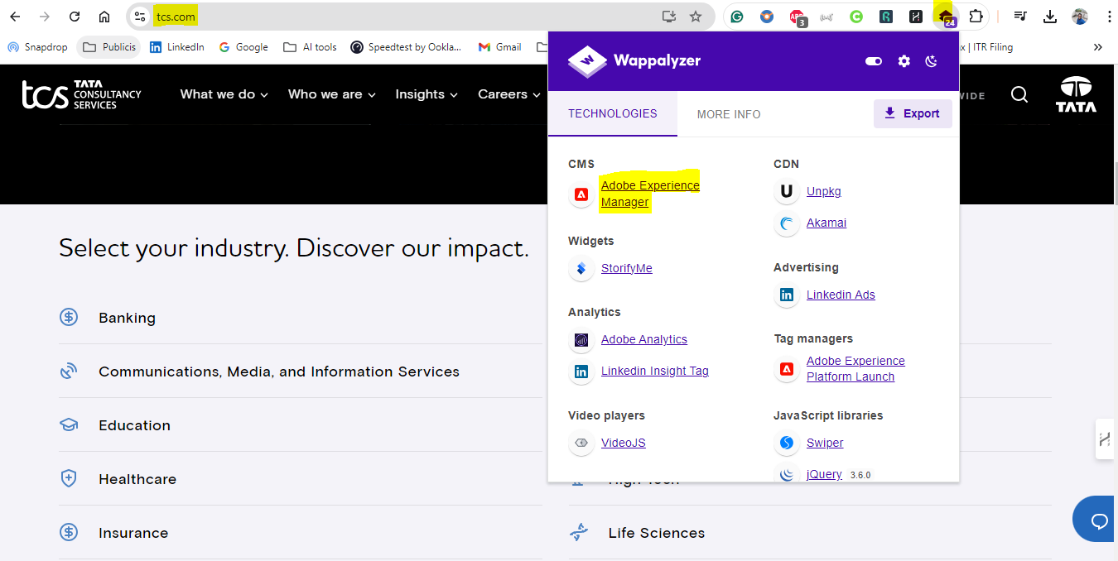
Task 3 - Website Platform Identification:
Website Link: https://www.tcs.com/ Platform: The website is developed on Adobe Experience Manager, as identified using Wappalyzer - Google Extension.

Slide 6
Task 4 - Responsive Design Testing
Tools Used: Google Mobile-Friendly Test, GTmetrix, and Light House.
Report:
1. Homepage: Improve performance by reducing unused JavaScript and optimizing large images.
2. Services Page: Enable text compression and remove render-blocking resources for faster mobile loads.
3. Careers Page: Prioritize visible content for quicker initial rendering on mobile.
4. About Us Page: Implement lazy loading for better performance.
5. Contact Us Page: Ensure that mobile accessibility features like contrast and labels are optimized.
For more details, view the full report [here](https://pagespeed.web.dev/analysis/https-www-tcs-com/ypnqxiqxfk?form_factor=mobile&category=performance&category=accessibility&category=best-practices&category=seo&hl=en-US&utm_source=lh-chrome-ext).

Slide 7
Task 5 - Website Mistakes Identification
Based on the Cloudinary Web Speed Test results:
Identified Website Design Mistakes:
1. Slow Initial Load Time:
- The website has a slow initial load time, which can affect user experience.
2. Large Resource Sizes:
- Some resources, such as images and scripts, are large and contribute to slower loading times.
3. Too Many HTTP Requests:
- The site makes a high number of HTTP requests, which can impact performance.
4. Render-Blocking Resources:
- Certain CSS and JavaScript files are blocking the page from rendering quickly.
5. Unoptimized Images:
- Some images are not optimized for web use, increasing load times.

Slide 8
Suggestions for Improvement:
1. Reduce Initial Load Time:
- Optimize the website's server response times and implement lazy loading for non-critical resources to speed up the initial load.
2. Optimize Resource Sizes:
- Compress images and scripts and use modern formats like WebP for images to reduce their file sizes.
3. Minimize HTTP Requests:
- Combine multiple CSS and JavaScript files into single files to reduce the number of HTTP requests. Use CSS sprites for images when possible.
4. Eliminate Render-Blocking Resources:
- Move critical CSS inline and defer non-essential JavaScript to avoid blocking the rendering of the page.
5. Implement Efficient Image Optimization:
- Use responsive images and modern formats to ensure images are appropriately sized for different devices and screen resolutions.
Implementing these suggestions can help improve your website’s performance and user experience significantly.
Report link: https://webspeedtest.cloudinary.com/results/240912_AiDcYG_7WC

Slide 9
Task 6 - Website Best Practices List
Use an easy-to-navigate menu and add a search function if needed.
Keep a consistent look with matching colours, fonts, and logos.
Make sure the website works well and looks good on all devices.
Optimize images and files and combine scripts to cut down on loading time.
Choose readable fonts and use space wisely to avoid clutter.
Make sure the site is accessible to everyone and design clear, noticeable buttons.

Slide 10
Task 7 - Landing Page Design
Objective: Increase brand awareness for TCS Cognix service.
Landing page design - click here to view
https://tcscognixguvi.my.canva.site/

Slide 11
Conclusion
This project has effectively demonstrated key principles of digital marketing and website optimization, with a specific focus on enhancing TCS's web presence. Through detailed analysis, tools like Wappalyzer, Google Mobile-Friendly Test, and GTmetrix were utilized to assess and provide actionable insights for improving the TCS website's performance.
Critical issues, such as large resource sizes, slow initial load times, and render-blocking elements, were identified and addressed with tailored recommendations to optimize the site.
Additionally, by crafting a targeted landing page for TCS Cognix, this project highlighted essential strategies to increase brand visibility and improve lead generation.
The recommendations and best practices provided, including responsive design, image optimization, and reducing HTTP requests, serve as a foundation for continuous enhancement of the TCS digital platform.
The insights gained from this project will contribute significantly to improving TCS’s online presence, driving greater user engagement, and supporting their brand's growth in the digital space.

Slide 12
Thank You!

